Slide 1
A Brief History of Computers, the Internet and the Universe
By L. Gillett
Webmaster
MMC

Slide 2
In The Beginning….

Slide 3
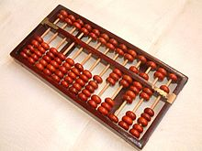
Step One
The first machines that could be called a computer were the simple Abacus devices used to make quick math calculations and to record the results.
Although they were non-motorized, they are computers because they are a machine that performs calculations
The Abacus was invented as early as 3000 years BC

Slide 4
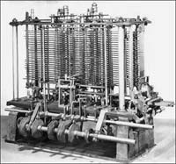
Step Two
The next big step in computers happened in the 1820’s with Charles Babbage. He created a mechanical device that could perform calculations and then print out the results
This was the Difference Engine created in 1822
Babbage designed a more complex Analytical Engine in 1837 but it was not able to be properly built and function until 1910, by his son Henry Babbage.

Slide 5
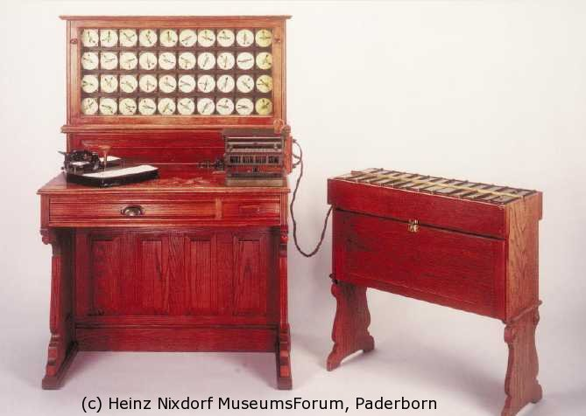
Step Three
In the 1890’s, a man named Herman Hollerith started the Tabulating Machine Company which used a machine to read data from punch cards and then perform calculations and print a result.
These tabulating machines were used by the US Census in 1890, doing 7 years of calculations from the previous census in just 6 weeks, saving the government time and millions of dollars.
The Tabulating Machine Company continued on producing calculating machines and later changed its name to the International Business Machine Company.

Slide 6
Turn on the lights….

Slide 7
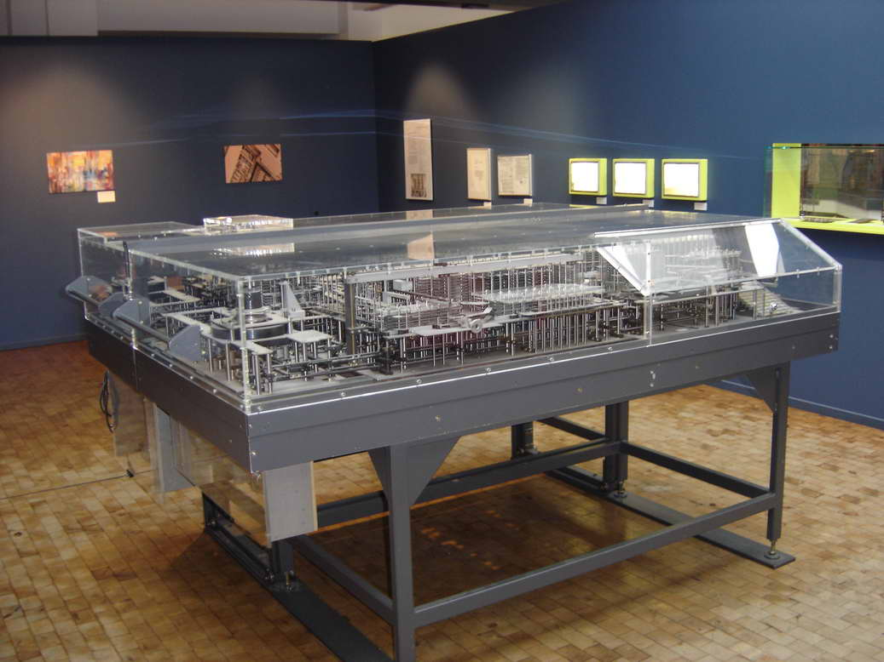
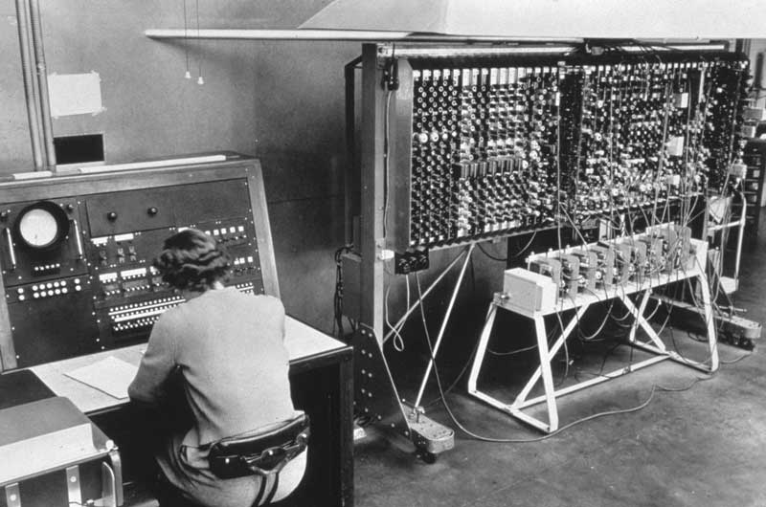
Step four
In 1936 we get a breakthrough in electrical computing machines that could take a set of programmed instructions and complete them. This was the start of the modern computer age
The first in this new age of computers were the Z1, made by Germany’s Konrad Zuse (top picture), and the Turing Machine, created by Alan Turing (bottom picture)
Through World War II both sides found uses for computers to help create and break communication codes. The Colossus was the famous British computer that was able to break German codes and help win the war.

Slide 8
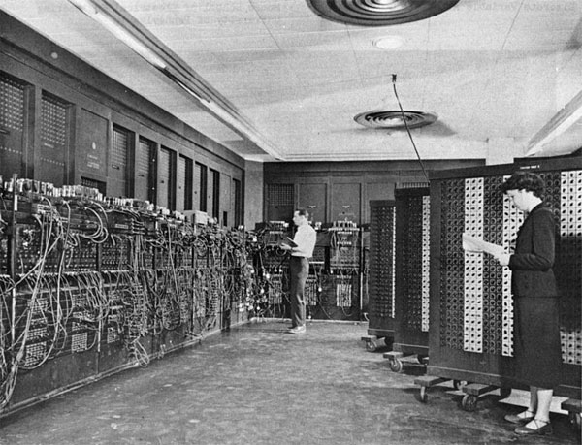
Step five
The ENIAC was invented by J. Presper Eckert and John Mauchly at the University of Pennsylvania and began construction in 1943 and was not completed until 1946.
ENIAC occupied about 1,800 square feet and used about 18,000 vacuum tubes, weighing almost 50 tons.
The ENIAC is thought to be the first digital computer because it was fully functional.

Slide 9
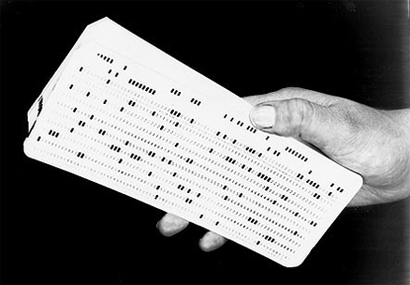
Up til now, all computers run only on programs stored on punch cards and fed into the machine
There is no stored data and any interruption in the machine meant starting the input all over again.
Another problem…. Your program could be made up a hundred punch cards. Any one out of order would mean your program run would fail.

Slide 10
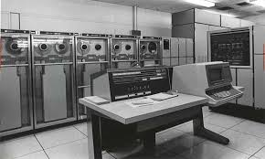
Step six
Programmers needed some way to store data and programs so that they could be run multiple times without entering data and wasting time.
In 1950 we get the first UNIVAC computes, created by the makers of ENIAC. These were the first to be able to store and run a program from memory.
These machines used many reel to reel magnetic tape machines to store and access memory. This is the same technology as music cassette tapes.

Slide 11
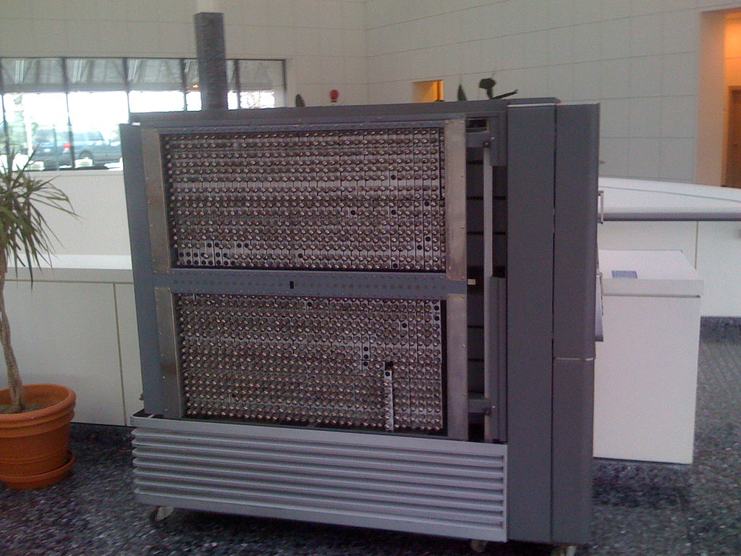
Step seven
1953, The Tabulating Machine guys are still at it; now called International busness machines.
IBM produced the 701 computer for the masses. Sleek and compact, it was still not exactly a desktop model.

Slide 12
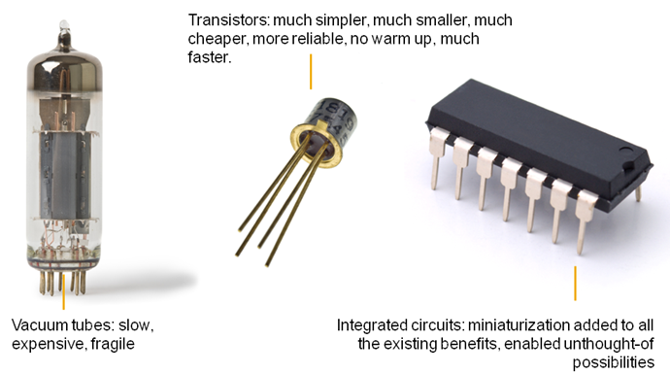
Step Eight: no more tubes
Computers are huge contraptions at this time. Accessible to Governments (Military), Big Businesses (banking, stocks) and some Universities.
Computers take up huge amounts of space and are only really useful for doing large number crunching activities.
It wasn’t until the invention of the transistor in the late 40’s and later, the integrated circuit that we saw anything like the size of the computers of today.

Slide 13
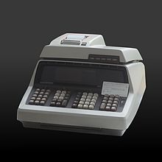
By 1968 computers have completely transformed into transistor based machines, with magnetic RAM and graphical interfaces.
The first mass-produced PC was sold by Hewlett Packard; the HP 9100A

Slide 14
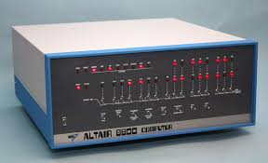
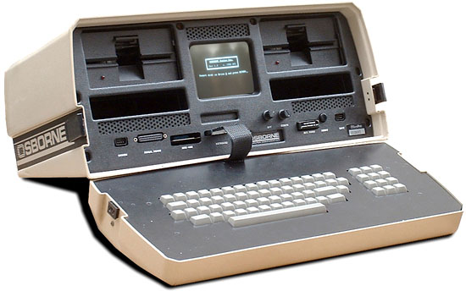
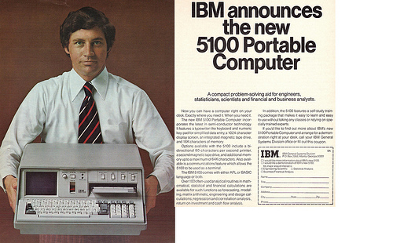
Step Nine: Micro
Then comes the Microprocessor, the power of a computer in the size of your palm. The first was the Intel 4004 made in 1971
Miniaturization brought a revolution to computers
1975, the first ‘personal computer’ is made; the Altair 8800, using switches for input and lights showing the result
1975, the IBM 5100 is released, with a 5 in screen and tape drive.
1981, the first laptop computer, the Osborne I, weighed 24.5 lbs, had a 5 in screen, 64 Kb of memory, two floppy drives and cost $179

